Slide 1



Day 1 Afternoon:
Security Hazards in Smart Contracts
Andrew Miller
Initiative for CryptoCurrencies and Contracts
Decentralized Systems Lab
University of Illinois at Urbana-Champaign
@socrates1024

Slide 2
Warmup: Rock Paper Scissors in Ethereum
1. function add_player() payable;
Takes player’s deposit of 1 ETH.
2. function input(uint choice);
Records player’s choice (0 or 1 or 2)
3. function check_winner();
Decides who wins, pays the winner

Slide 3
uint num_players = 0;
uint reward = 0;
mapping (uint => Player) player;
function check_winner() returns(int) {
var p0_choice = player[0].choice;
var p1_choice = player[1].choice;
if (p0_choice - p1_choice % 3 == 1)
// Player 0 wins
player[0].addr.send(reward);
else
if (p0_choice - p1_choice % 3 == 2)
// Player 1 wins
player[1].addr.send(reward);
else {
player[0].addr.send(reward/2);
player[1].addr.send(reward/2);
}
}
struct Player {
uint choice;
uint addr;
}
function add_player() payable {
assert(num_players < 2);
assert(msg.value >= 2000 szabo);
reward += msg.value;
player[num_players].addr = msg.sender;
player[num_players].choice = choice;
num_players++;
}
function input(uint choice, uint idx) {
assert(msg.sender == player[idx].addr);
player[idx].choice = choice;
}

Slide 4


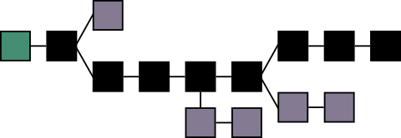
One problem: Front Running
Rock!
Paper!
Seconds go by....

Slide 5
Avoid Front-Running with Commitments
nonce0 ← Random String
H0 = hash( nonce0, “Rock” )
nonce1 ← Random String
H1 = hash( nonce1, “Scissors” )
Commit to H0
Commit to H1
Commitment Deadline
Reveal
nonce0, “Rock”
Reveal
nonce1, “Scissors”

Slide 6
Why are the “nonces” necessary?
H0 = hash( “Rock” )
commit(H0)

Slide 7
Avoid Front-Running with Commitments
What remaining problems are there?
nonce0 ← Random String
H0 = hash( nonce0, “Rock” )
nonce1 ← Random String
H1 = hash( nonce1, “Scissors” )
Commit to H0
Commit to H1
Commitment Deadline
Reveal
nonce0, “Rock”
Reveal
nonce1, “Scissors”

Slide 8
Security Hazards in Smart Contract Programming

Slide 9
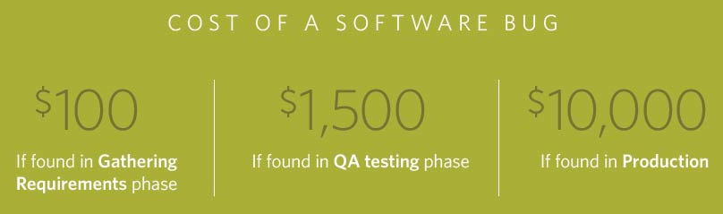
Bugs occur in all software
A 2003 study commissioned by the Department of Commerce’s National Institute of Standards and Technology found that software bugs cost the US economy $59.5 billion annually.
In Smart Contracts, they’re easily monetized

Slide 10
In this talk: Stories of failures
from Ethereum’s first 2 years

Slide 11


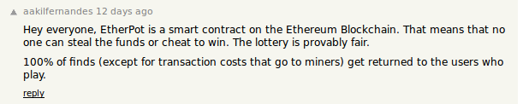
The E therpot Story
August 26, 2015

Slide 12
How Etherpot Works
Subpot
Subpot
1. Each round lasts 1 day. (Everything is reset after a round.)
2. Users deposit money to purchase Tickets at a fixed price.
Each “Subpot” holds a fixed number of tickets.
3. After the round ends, the next N block hashes are used as random seeds to determine the winners of N subpots.
(1 block for each subpot)
$1
Ticket
Ticket
$1
Ticket
$1
Ticket
$3
$1
$1
Block hashes used as random seeds

Slide 13

Bugs in Etherpot
Within days, hundreds of dollars of Eth paid out to the wrong recipient.
Multiple more bugs were found.
Notes:
- Call stack bug (loses funds, if miner is bad or attacker is fast)
- Block number bug (miner steals funds if winner is offline)
- Misaligned incentives (miners can cheat)

Slide 14
Many idioms for calling functions
100 Amount in Ether
25 Amount in gas
55 Data argument
Serpent:
Exception behavior Gas sent
send(recipient, 100) returns 0 all of it
send(25, recipient, 100) returns 0 25
recipient.foo(55) returns 0 all of it
recipient.foo(55, gas=25) returns 0 25
Solidity:
recipient.send(100) returns 0 minimum
recipient.call.value(100).gas(25)() returns 0 25
recipient.foo.value(100)(55) exception all of it
recipient.foo(55) exception all of it

Slide 15
Call stack hazard:
Maximum call stack depth is 1023
Suppose we call A.recurse(0). Does Alice get 100?
Stack depth = 1023
Contract A:
function recurse(int i) {
if (i == 1022)
return B.b() + “World”;
else recurse(i+1);
return OK;
}
Contract B:
function b() {
C.send(100);
return “Hello “;
}
Contract C:
function() {
Alice.send(100);
}
A.recurse(0) Stack depth = 0
A.recurse(1) Stack depth = 1
….
A.recurse(1022) Stack depth = 1022
Returns “Hello World!”

Slide 16
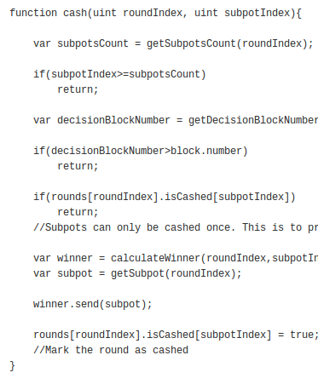
The Callstack hazard in Etherpot
https://gist.github.com/amiller/665cc46970f2c0684d2a
….
Attack Contract:
function recurse(int i) {
if (i == 1022)
Etherpot.cash(r,idx)
else recurse(i+1);
return OK;
}
Result: attacker can destroy all the funds in the contract

Slide 17
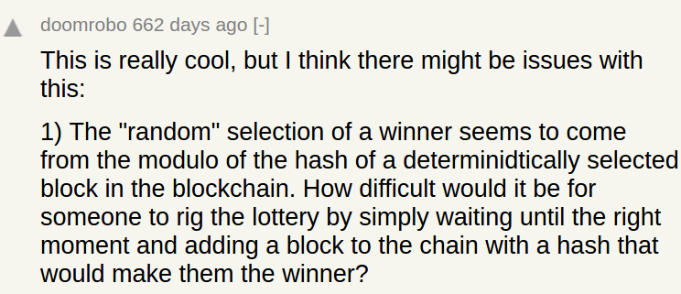
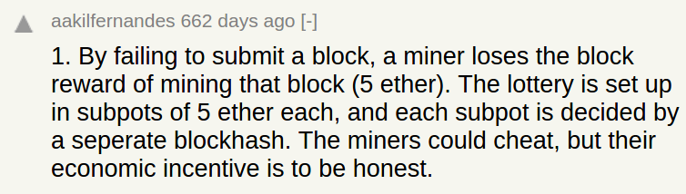
EtherPot’s incentive mechanism

Slide 18
EtherPot’s incentive mechanism
Can miners influence the outcome of lottery?
Yes - by withholding blocks
Solution: “subpots” smaller than block reward
Problem: GHOST
Withheld blocks can still get 88% reward if revealed in the next round

Slide 19
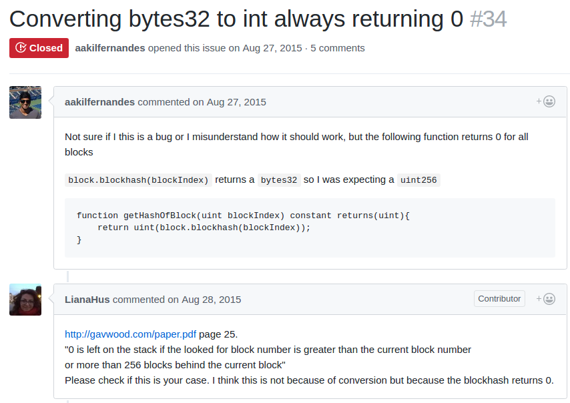
Block number bug
function getHashOfBlock(uint blockIndex) constant returns(uint){
return uint(block.blockhash(blockIndex));
}
Index of the block that determines lottery outcome
Hash of that block

Slide 20
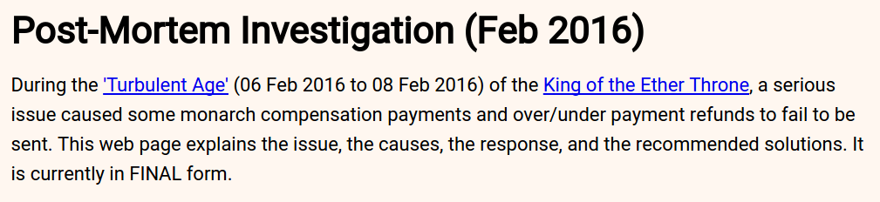
King of the Ether Throne

Slide 21
Call stack hazard:
Exceptions are not propagated (for default function)
Example: an exception caused by Out of Gas
Minimum amount of gas (2300)
Contract Wallet:
function() { // handle payment
// Do more than 2300
// gas worth of work
}
Contract A:
function payWinnings() {
Winner.send();
selfdestruct;
}
Out of gas
Result: If you played King of Ether Throne using a
“Wallet Contract”, your winnings would be destroyed forever.

Slide 22
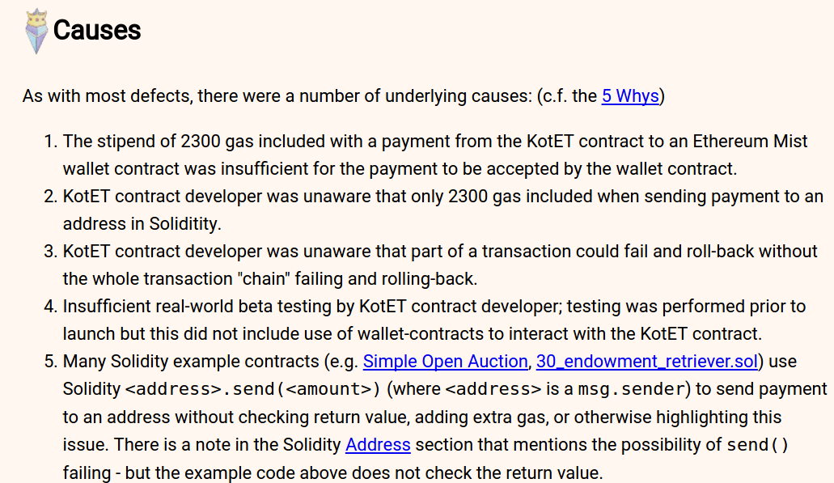

Slide 23
All about TheDAO

Slide 24
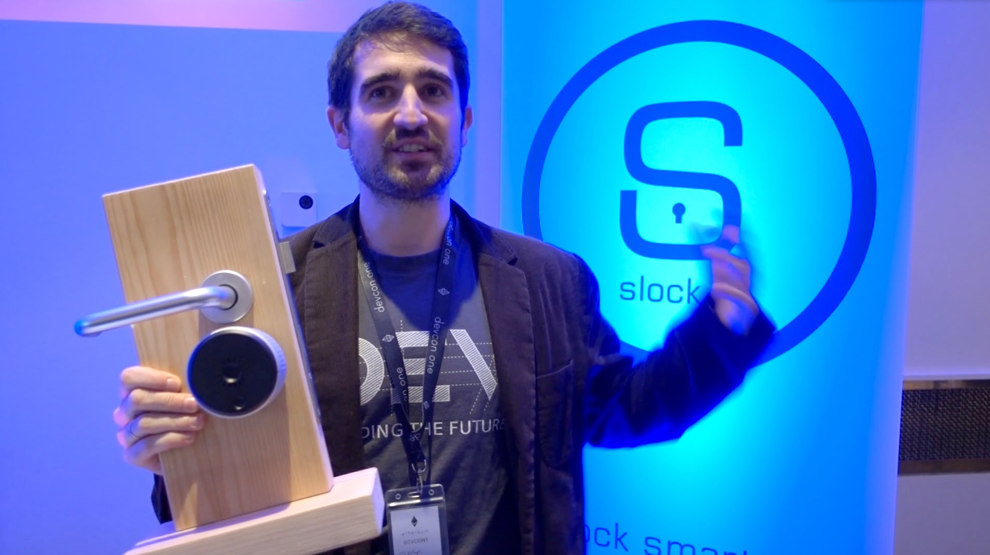
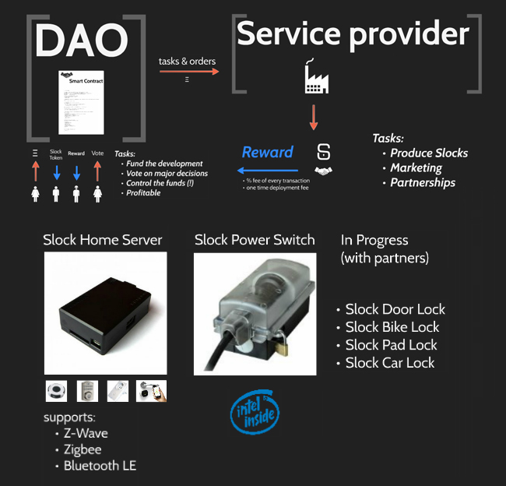
slock.it a Blockchain + IoT company
Example use case:
1. AirBnB user submits payment to the Ethereum blockchain
2. Slock Home Server (Ethereum client) receives the transaction
3. Power switch connected to Home Server receives “unlock” command, unlocks the door

Slide 25
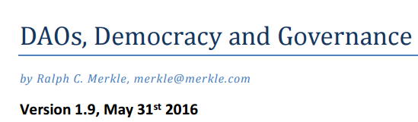
slock.it built The DAO as a custom fundraising tool
“DAO”: Decentralized Autonomous Organization (coined by Vitalik in 2013)
Built by slock.it to raise funds for their company
Main idea: A decentralized hedge fund
Investors contribute funds, receive ownership “tokens”
Investors jointly decide how to spend funds, by voting in proportion to tokens
Many additional mechanisms:
“Splitting” to prevent hostile takeover
Reward disbursing

Slide 27
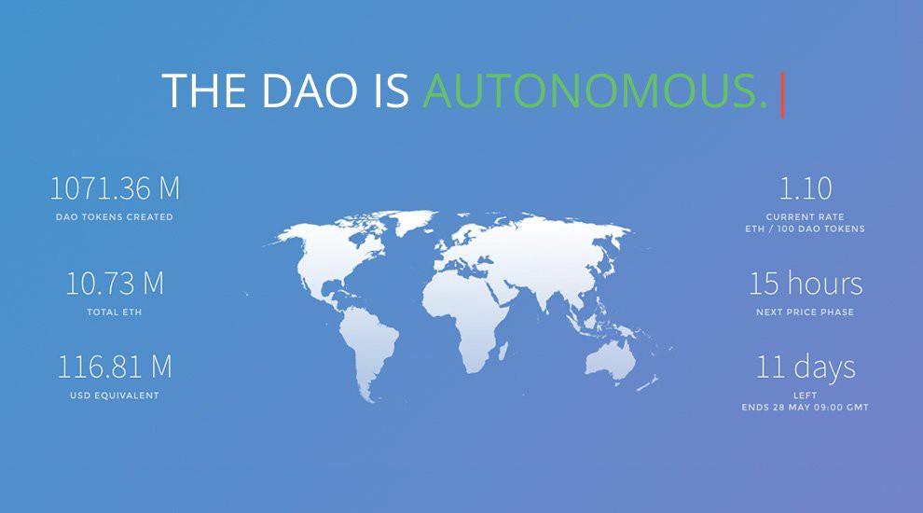
Raised ~150 million dollars in ~ 1 month

Slide 28
Re-entrancy hazards in Ethereum
Balance
0
100
Contract
function doWithdraw() {
A.withdraw(100);
}
function() {
EventMoneyReceived(msg.value);
}
Balance
300
200
balances[attacker]
0
100
Contract A:
mapping (address => int64) balances;
function withdraw(uint x) {
if (balances[msg.sender] >= x)
callee.call.value(balance)();
balances[msg.sender] -= x;
}

Slide 29
Re-entrancy hazards in Ethereum
Balance
0
100
200
300
Attacker Contract
function startAttack() {
A.withdraw(100);
}
function() {
A.withdraw(100);
}
Balance
300
200
100
0
balances[attacker]
-300
0
-100
-200
100
Contract A:
mapping (address => int64) balances;
function withdraw(uint x) {
if (balances[msg.sender] >= x)
callee.call.value(balance)();
balances[msg.sender] -= x;
}

Slide 30
Timeline and Aftermath of The DAO
- June 12: slock.it developers announce that the bug is found, but no funds at risk
- June 17 (Morning): attacker drains ⅓ of the DAO’s Ether ($50M) over 24 hrs
Attacker’s funds were trapped in a subcontract for 40 days (July 27)
- June 17 (Evening): Eth Foundation proposes a “Soft Fork” to freeze the funds
- June 28: Cornell freshmen identify a flaw in the Soft Fork Proposal
- July 15 (Morning): Eth Foundation proposes a “Hard Fork” to recover funds
- July 15 (Evening): “Ethereum Classic” manifesto published on github
- July 19: “Hard Fork” moves funds from attacker’s contract to recovery contract
Ethereum Classic blockchain survives and is traded on exchanges
Both Ethereum and Ethereum Classic are both around, reached new peaks

Slide 31
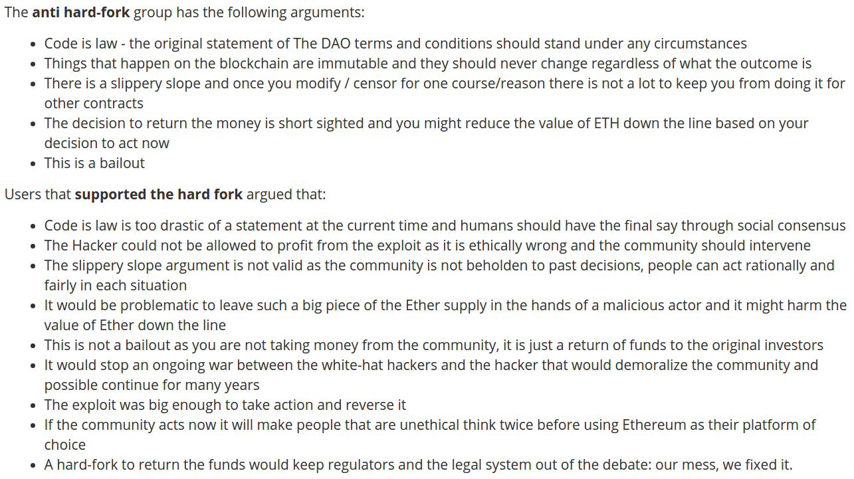

Slide 32
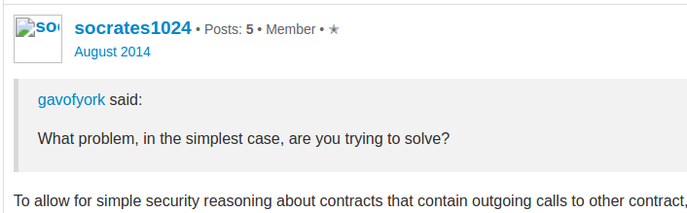
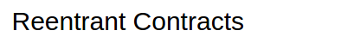
The “I told you so” report
2014: Forum post on re-entrancy hazards
- Suggested mitigations at the language level

Slide 33
The “I told you so” report
2014: Forum post on re-entrancy hazards
- Suggested mitigations at the language level
2015: ETH-commissioned report on EVM security
- Official ETH examples (crowdfund.se) also exhibit this flaw
(they happen not to be exploitable, but without showing why)
“the refund callback could make a new donation, triggering another refund cycle, potentially double-refunding the earlier contributions, or failing to refund later ones”
2016: The DAO happens anyway

Slide 34
The “Checks / Effects / Interactions” paradigm
A Best Practice guideline for safe smart contract behavior
When receiving a message, do the following in order:
1. Perform all input validation and checks on current state. Discard the message if validation fails.
2. Update local state.
3. Finally, pass on interactions to trigger other contracts.
Contract A:
public address callee;
public int balance = 100;
…
function withdraw()
only(callee) {
if (balance <= 0) return;
var toSend = balance;
balance = 0;
callee.recv.value(toSend)();
}

Slide 35
Replay Attacks across Hard Forks

Slide 36
Hard Forks in Ethereum
- Ethereum has had several hard forks
- July 20th, 2016 (to cancel “The DAO” attack)
- October 18, 2016 - November 22, 2016 Mitigate DoS attacks
- Ethereum’s July 20 fork preceded a split: ETH and ETC (Ethereum Classic)
ETC is traded on exchanges, currently ~1/20 size of ETH (market cap)
No evidence of “un-upgraded nodes”
ETC has also hard forked, Oct 25, 2016

Slide 37
Replay attacks on Exchanges
Exchange
User Accounts
...
Alice: $50
...
Ethereum
...
$100
...
$60
1. Blockchain splits
Alice has $10 in ETH and
$10 in ETC
$60
$110
$100
Alice -- $10 -> Exchange
2. Alice mines a deposit tx on ETH and a self-send on ETC
Alice -- $10 -> Alice
Exchange -- $10 -> Alice
Result: the exchange doesn’t care about ETC, so it doesn’t even try to play the ETC game
3. Alice withraws. Exchange issues a withdrawal on ETH, which also gets mined on ETC
Alice -- $10 -> Exchange
Exchange -- $10 -> Alice
ETH
Exchange: $100
Alice: $10
ETH
Exchange: $100
Alice: $10
ETH
Exchange: $110
Alice: $0
ETH
Exchange: $100
Alice: $10
ETC
Exchange: $100
Alice: $10
ETC
Exchange: $100
Alice: $10
ETC
Exchange: $90
Alice: $20
Alice -- $10 -> Alice
Exchange -- $10 -> Alice

Slide 38
ERC 20 Tokens

Slide 39
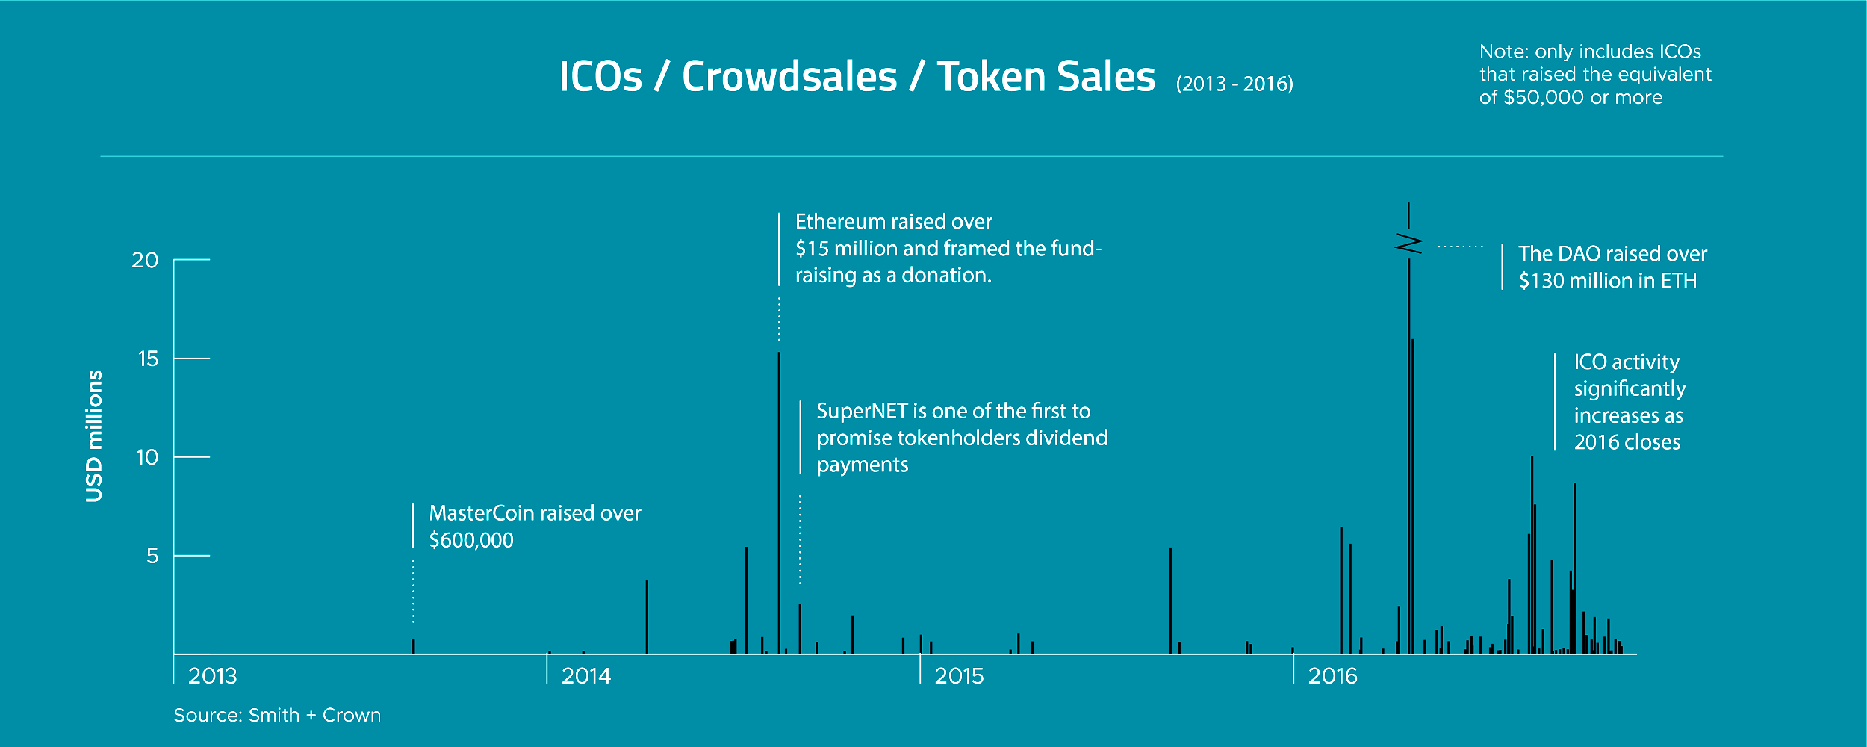

Slide 40
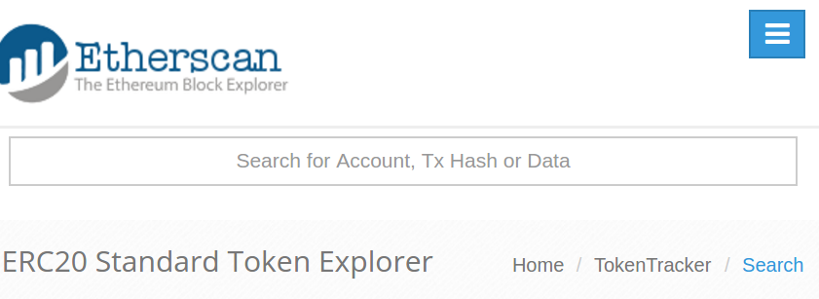
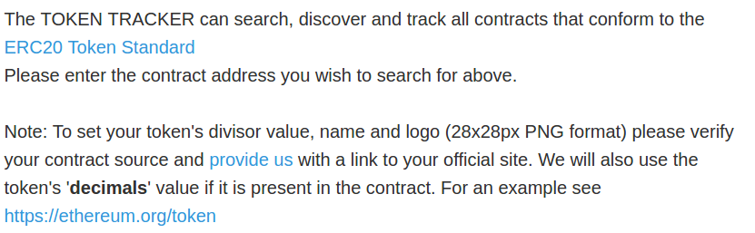

Slide 41
ERC20 defines interfaces for basic token behavior
Basic functionality:
function totalSupply() constant returns (uint256 totalSupply)
function balanceOf(address _owner) constant returns (uint256 balance)
Delegating control:
function transfer(address _to, uint256 _value) returns (bool success)
function transferFrom(address _from, address _to, uint256 _value) returns (bool success)
Delegating control:
function approve(address _spender, uint256 _value) returns (bool success)
function allowance(address _owner, address _spender) constant returns (uint256 remaining)

Slide 42
Failure of ERC20 token exchanges
Several online exchanges allow you to transfer tokens from a web form
Assumption: All interactions with contracts respects function interface
function transfer(address _to, uint256 _value) returns (bool success)
Reality: compiled EVM interprets all data as array of 32-byte blocks
var callData = "0"*12 + ($(#userAddr).val()) + toHex($(#amt).val(), 32)
Attack: attacker finds a key for an address of the form 0xAAAAAAAA...AAAAA000
and types the 17-byte prefix into the #amt field
0000...0000 AAAAAAAA...AAAAA000 00000...0000000055000
Example:
0000...0000 AAAAAAAA...AAAAAAAA 00000000...0000000055
padding
20 byte address
value (little endian, 32 bytes)

Slide 43
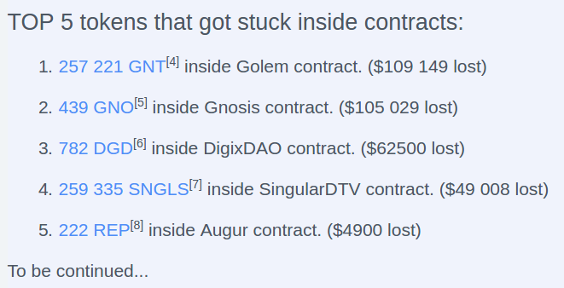
ERC20 Tokens lost because of other errors
https://www.reddit.com/r/ethereum/6e8y9o/

Slide 44
Most recent: Parity Wallet bug
- $30 million drained due to an exploitable bug
- An “initialize()” function to set the owner of the contract, was missing the “onlyOnce” modifier
- Process error more than anything -> mistriaged as “UX upgrade,” skipped review

Slide 45
Many things we can do to improve smart contract security
- Trial by fire - we learn about pitfalls to avoid by watching others’ mistakes (status quo)
- Design “language abstractions” for making secure-by-construction programs
- Design program analysis tools to exclude classes of errors

Slide 46
Many reasons why nothing might get done
Fear-of-Missing-Out vs. Prudence
Externalities
Failures drag the price down for everyone
Who should take responsibility for security?
Investors?
App developers?
Protocol engineers/stewards?

Slide 47
More resources on Smart Contract Security
- ConsenSys’s “Smart Contract Best Practices”
- K EVM Semantics http://hdl.handle.net/2142/97207
- Oyente tool catches some errors “Making Smart Contracts Smarter”
- Formal Verification of Smart Contracts - compiler written/checked in F*
- A survey of attacks on Ethereum smart contracts
- An empirical analysis of smart contracts: platforms, applications, and design patterns
- Step by Step Towards a Safe Smart Contract

